Slide 1
NIGERIA 2026 FEDERAL APPROPRIATION BUDGET
PRESENTED BY: DATA WIZZARDS (TEAM 48)

Slide 2
PROJECT OVERVIEW
This project was commissioned by a leading Nigerian television station as the data backbone for a prime-time investigative report on the 2026 Federal Appropriation Budget. The target audience is everyday Nigerians, market traders, teachers, civil servants, parents, and young professionals, who pay taxes and deserve to understand, in plain language, where their money is going.
The total appropriation under analysis is ₦58,472,628,944,759 — Fifty-Eight Trillion, Four Hundred and Seventy-Two Billion Naira — for the fiscal year ending 31 December 2026.

Slide 3
Analytical Questions
Three analytical questions were selected for investigation. Each question was chosen because the budget data can answer it fully, no external datasets required, and because the answer reveals something that everyday Nigerians need to hear.

Slide 4
Question 1: Deficit & Debt Burden
"Nigeria Spends ₦1.76 For Every ₦1 It Earns“
₦33.2T
Total Revenue
What Nigeria earns
 | ₦58.5T Total Expenditure 176% of revenue | ₦25.3T Fiscal Deficit 76.1% of revenue | ₦15.9T Debt Service 47.9% of revenue

Slide 5
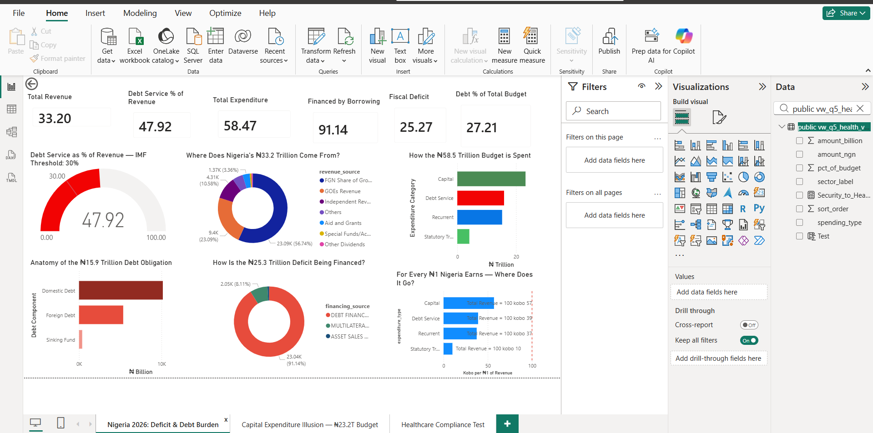
Key findings
IMF Debt Service Gauge- Debt service (47.92%) vs. IMF 30% benchmark: Nigeria is nearly 18 percentage points above the international danger threshold.
Revenue Source Donut- Breakdown of ₦33.2T revenue by source: The Federation Account (oil) contributes 56.74% — Nigeria's revenue base is dangerously narrow.
Expenditure Bar Chart- How ₦58.5T is split across categories: Capital (₦23.2T) is largest, but Debt Service (₦15.9T) exceeds Recurrent spending.
Debt Composition Bar- How ₦58.5T is split across categories: Capital (₦23.2T) is largest, but Debt Service (₦15.9T) exceeds Recurrent spending.
Financing Donut- How the ₦25.3T deficit is plugged: 91.14% financed by direct borrowing — asset sales contribute a negligible 0.7%
Kobo-per-Naira Bar- Cost of each category per ₦1 of revenue: Nigeria spends 176 kobo for every 100 kobo it earns — the deficit made tangible

Slide 6
What 91% Borrowing Means for the Future…?
The Borrowing Trap
Of the ₦25.3 trillion deficit, ₦23.04 trillion (91.14%) is financed through direct borrowing — domestic and foreign debt. Another ₦2.05 trillion comes from project-tied loans. Only ₦189 billion (0.75%) comes from asset sales. This means the 2026 deficit adds directly to Nigeria's debt stock. That debt will generate future interest payments — which will appear in the 2027 and 2028 budgets as even larger debt service line items. Nigeria is, in effect, borrowing to pay for a budget that is already largely consumed by repaying previous borrowings.

Slide 7
Question 4 — The Capital Expenditure Illusion
"Not All of ₦23.2 Trillion Is New Investment“
₦23.2T Total Capital Budget The headline figure | ₦17.6T True New Investment 75.6% of capital | ₦3.4T Loan-Funded 14.7% — new debt | ₦2.2T Carryover Obligations 9.6% — legacy debts

Slide 8
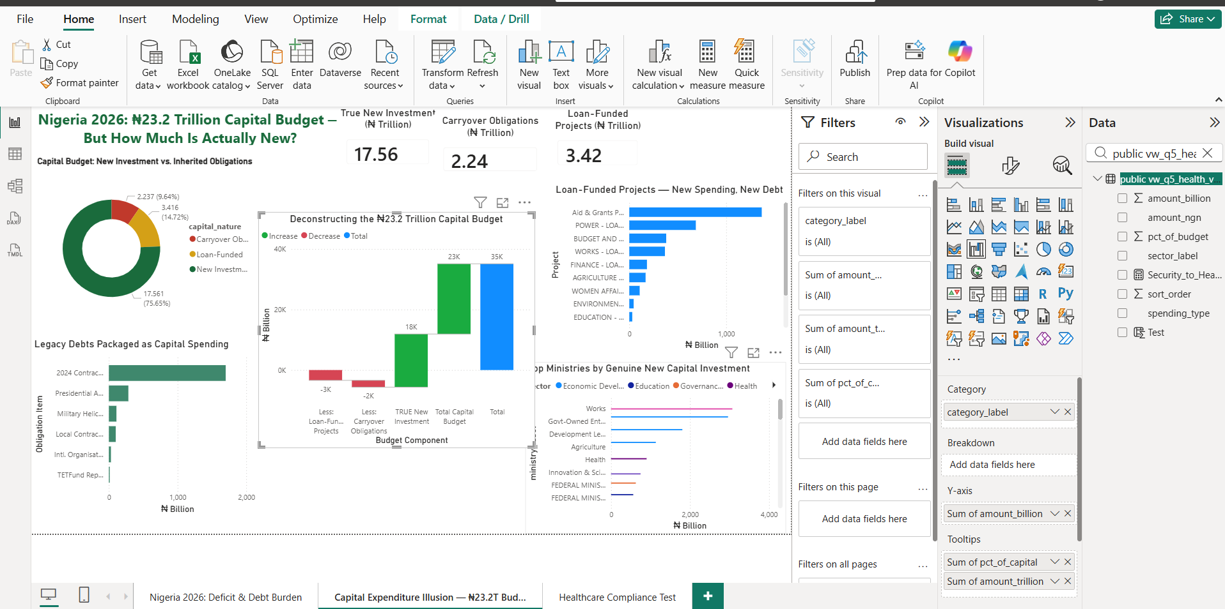
Key findings
Capital Nature Donut- 3-way split: New Investment, Loan-Funded, Carryover: The green 75.6% slice looks reassuring — until you examine what the red 9.6% contains.
Waterfall/Decomposition Bar- Total → minus carryover → minus loans → true new: The ₦23.2T shrinks by ₦5.7T before a single new project begins
Carryover Items Bar- All 6 legacy debt line items named and sized: ₦1.7T alone is for unpaid 2024 contractor bills — money owed for work already done
Loan-Funded Bar- All 12 multilateral/bilateral projects: Power and Works ministries dominate — ₦1.05T of loan-funded infrastructure
Top MDAs New Investment- Which ministries get the most genuine new capital: Federal Ministry of Works commands ₦3.07T — 17.5% of all true new investment

Slide 9
Question 5 — The Healthcare Compliance Test
"Nigeria's Health Budget Is Compliant — But By a Dangerous Margin“
Legal Requirement:
Section 4 of the 2026 Appropriation Bill, "Targeted Health Interventions, investment in Healthcare, should not be less than 6% of total Budget size, net of Debt Service and Liabilities." This is not a policy aspiration. It is written into law in the Appropriation Bill itself, the same document that authorises every other naira of spending.

Slide 10
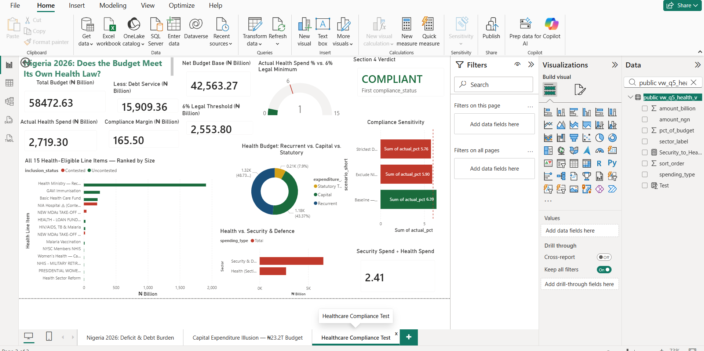
Key findings
COMPLIANT Banner- Green card showing Section 4 verdict: The budget passes, but the sensitivity test tells the real story
Compliance Gauge - Actual 6.39% vs. legal minimum 6.00%: The needle is barely above the red line, a 0.39 percentage point margin
Health Line Items Bar- All 15 health-eligible lines ranked by size: Two items; Health Ministry recurrent (₦1,010Bn) and capital (₦898Bn), make up 70% of the total
Health by Type Donut - Recurrent vs Capital vs Statutory split:48.76% recurrent, 43.33% capital, 7.90% statutory, a structurally healthy balance
Sensitivity Bar Chart – 3 compliance scenarios tested: Remove one building (NIA Hospital) and Nigeria falls out of compliance
Health vs Security Bar - Side-by-side sector comparison: Security gets ₦6.55T, 2.41 times the entire health-eligible budget

Slide 11
The NIA Hospital Question
A ₦208 billion intelligence-sector hospital is the single item keeping Nigeria on the right side of its own health law. The Nigeria Intelligence Agency Hospital is classified as a health-eligible capital investment, but it serves the intelligence community, not the general public. Whether this constitutes a "targeted health intervention" as envisioned by Section 4 is a question the legislature, civil society, and citizens should ask. Remove it, and Nigeria's health budget falls from 6.39% to 5.90%, below the legal minimum.

Slide 12
Health vs. Security: The Values Question
The final chart on Page 3 places the health budget in its sharpest context. Nigeria's Security & Defence sector, including the Ministry of Defence, Police Affairs, Ministry of Interior, National Security Adviser, and related operations, receives a combined ₦6.55 trillion. The entire health-eligible budget is ₦2.72 trillion.
For every ₦1 Nigeria spends on health, it spends ₦2.41 on security and defence. Security is a legitimate priority for a country facing real insurgency threats. But for the 200 million Nigerians whose greatest daily threat is not a bullet but a preventable disease, the cost of an overwhelmed health system is measured in lives, not statistics.
₦6.55T Security & Defence Total 11.20% of total budget | ₦2.72T Health (Section 4 Eligible) 4.65% of total budget | 2.41× Security ÷ Health Ratio For every ₦1 on health

Slide 13
Overall Conclusion
"The Budget of a Nation Tells You What It Values. This One Tells You What It Owes."
Three questions. Three answers. One consistent story.
Nigeria's 2026 budget is not a plan for development. It is a statement of accumulated obligations. Before a single road is built, a single teacher is hired, or a single clinic is stocked, 76 kobo of every naira the government earns is already committed to debt repayment. The remaining capacity to govern is squeezed further by a capital budget that contains ₦2.24 trillion in legacy contractor debts and ₦3.42 trillion in new loans that will generate tomorrow's debt service.
The healthcare budget technically passes its own legal test, but only when a ₦208 billion intelligence-sector facility is counted as a public health investment. Strip that single item, and Nigeria violates the law it wrote for itself.

Slide 14
THANK YOU

